Slide 1

Fatigue Test Modeling For The European INCEFA-SCALE Project
Author: Raphael ALVES HAILER
ENSTA Paris tutor: Anne-Lise GLOANEC
Host organization tutor: Stéphan COURTIN

Slide 2
1
2
3
Introduction and contextualization
Theoretical foundations of fatigue assessment
The Chaboche Constitutive Model
4
5
6
Multi-objective optimization and evolutionary algorithms
Results and discussion
Conclusion
2/62

Slide 3
1
Introduction and contextualization
3/62

Slide 4
The nuclear industry
The nuclear sector is crucial in the global energy landscape
As of 2021, 69% of France’s total generation comes from nuclear plants
Considered a clean energy source
Problem of aging
Average nuclear reactor age worldwide: 31.9 years
In Europe, the average is of 35.6 years
Susceptibility to failure due to Fatigue
4/62

Slide 5
INCEFA-SCALE project
Counts with multiple academical and industrial partners
Framatome, CEA, Kaunas University of Technology (KTU), …
Works on Environmentally Assisted Fatigue (EAF)
Objectives:
Fill the laboratory-to-scale knowledge gap
Improve the lifetime predictions of components in a Nuclear Power Plant (NPP)
Review international guidelines to enhance the reliability of NPP components, such as the NUREG/CR-6909 Revision 1 report, from the United States Nuclear Regulatory Comission (NRC)
5/62

Slide 6

Computational tools used
Numerical simulations conducted using Salome Meca
Combination of Salome and code_aster
Open source software developed by EDF
Possible to integrate Python, C++, C or Fortran code.
Salome:
Powerful tool for CAD modeling, meshing, pre-processing and post-processing
code_aster
Finite elements solver with easy to implement syntax
Possible to study a broad range of physical phenomena
6/62

Slide 7
Objective of this work
Conduct numerical simulations so as to:
Reproduce the experiments from INCEFA-SCALE partners on the SAE 316L stainless steel
Validate the use of code_aster to accurately describe the mechanical behavior of laboratory specimens
Compare Finite Elements Analysis (FEA) results with test results
Additionally, experiment with different Chaboche constitutive model parameter sets
7/62

Slide 8
2
Theoretical foundations of fatigue assessment
8/62

Slide 9
Motivation
Industrialization
Economy heavily based on mass production, driven by mechanized manufacturing
Machines and transports depending on axles and rotating pieces
Components subjected constantly to cyclic loads
Catastrophic failures
Often lethal, caused by the fatigue phenomenon
Affects different sectors, such as aeronautical, mining and railway
9/62

Slide 10
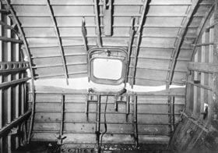
Motivation
Lithograph of the Versailles-Paris railway accident in may 8, 1842. Courtesy of the Bibliothèque Nationale de France
Failure due to cyclic pressurization in the de Havilland Comet I aircraft, the first commercial jet airliner, in 1954. Courtesy of the Royal Air Force (RAF) museum
10/62

Slide 11
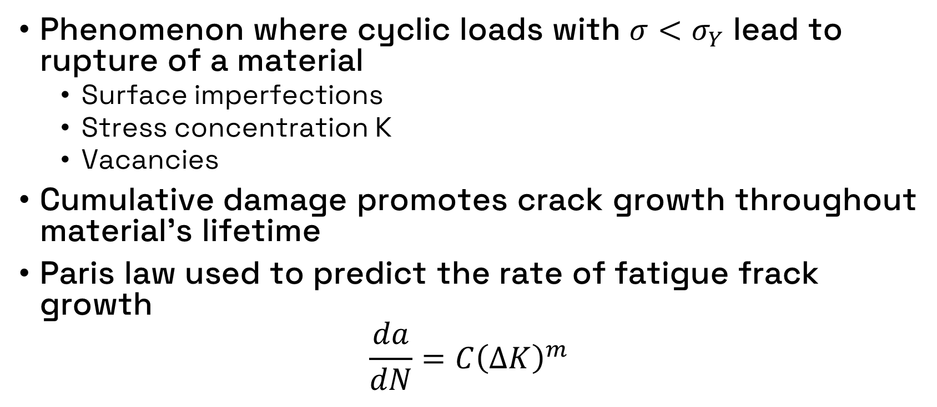
Fatigue
Phenomenon where cyclic loads with $σ<σ_{Y}$ lead to rupture of a material
Surface imperfections
Stress concentration K
Vacancies
Cumulative damage promotes crack growth throughout material’s lifetime
Paris law used to predict the rate of fatigue frack growth
$$\frac{da}{dN}=C{\left(ΔK\right)}^{m}$$
11/62

Slide 12
Crack Growth
Ahmadivala, Morteza: Towards optimal maintenance planning of existing structures based on time-dependent reliability analysis. PhD thesis, December 2020.
Ghodrat, Sepideh, Ton Riemslag, and Leo AI Kestens: Measuring plasticity with orientation contrast microscopy in aluminium 6061-t4. Metals, 7(4):108, 2017.
12/62

Slide 13
Fatigue life stages
Two fatigue life stages of interest for the INCEFA-SCALE project:
Maximum hardening stage
Early fatigue life
Material experiences cyclic hardening
Half life stage
Life stage where the number of cycles is half the necessary for rupture
Most real life machinery components are in this stage. Hence the importance of characterizing it accurately
Corresponding to stabilized cyclic behavior
13/62

Slide 14
3
The Chaboche Constitutive Model
14/62

Slide 15
Chaboche constitutive model
All numerical simulations considered the Chaboche constitutive model
Designed as a way to characterize the 316L stainless steel
Mathematical model with equations that account for the kinematic and the isotropic hardening effects
Particular focus on cyclic plasticity
Accounts for strain accumulation and recovering
15/62

Slide 16
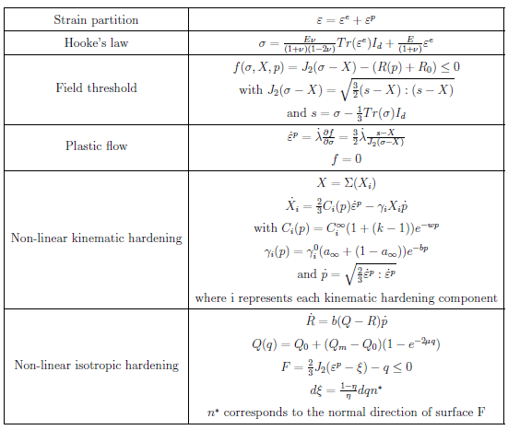
Chaboche constitutive model
code_aster is able to implement it easily
With history effect
Variable amplitude loading
Without history effect
In the present work, we consider 2 kinematic hardenings
One approach on parameter identification can be to solve an optimization problem
16/62

Slide 17
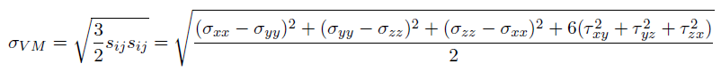
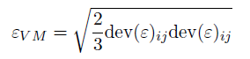
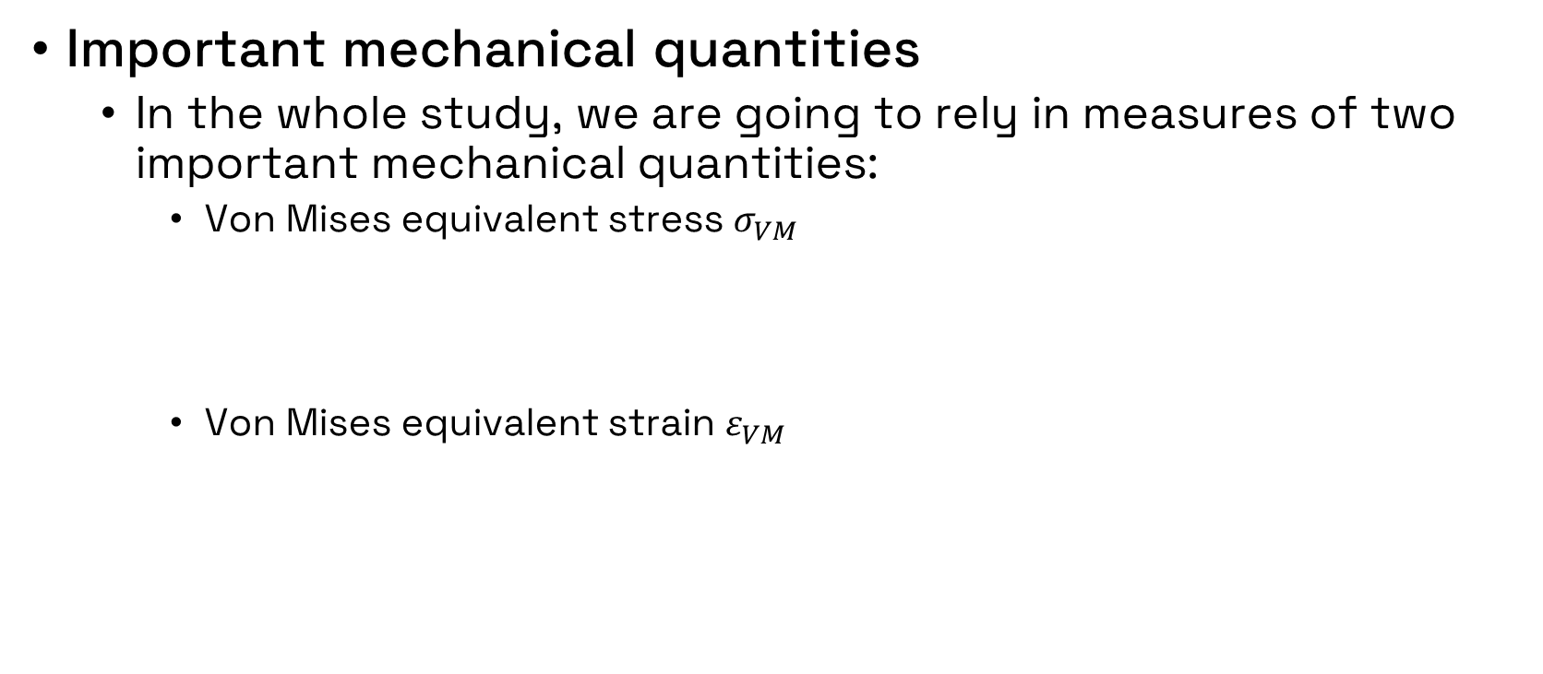
Chaboche constitutive model
Important mechanical quantities
In the whole study, we are going to rely in measures of two important mechanical quantities:
Von Mises equivalent stress $σ_{VM}$
Von Mises equivalent strain $ε_{VM}$
17/62

Slide 18
4
Multi-objective optimization and evolutionary algorithms
18/62

Slide 19
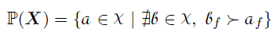
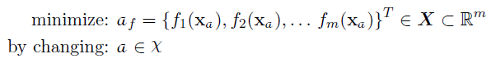
Basics of multi-objective optimization
Optimization problems where two or more objectives are considered
Objective: determine the Pareto front
Set of designs that dominates all others
Typical mathematical formulation without constraints:
19/62

Slide 20
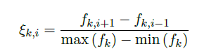
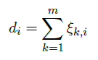
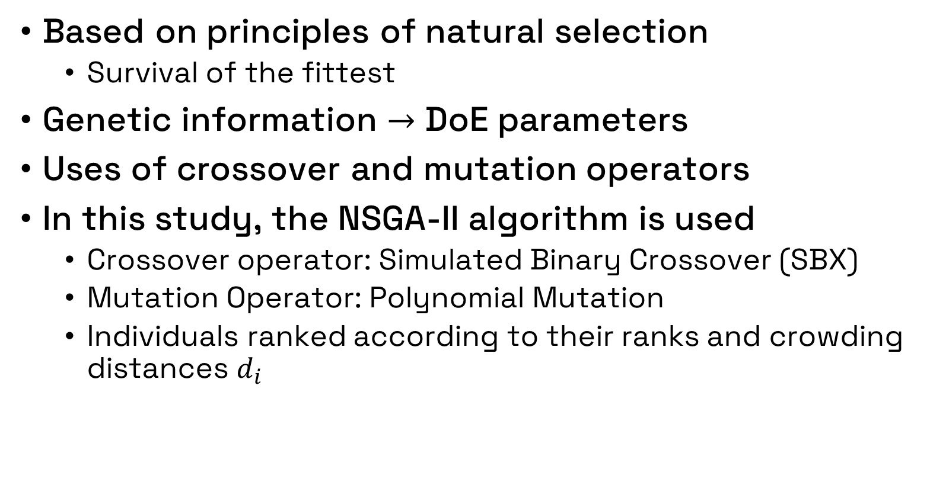
Evolutionary algorithms
Based on principles of natural selection
Survival of the fittest
Genetic information $→$ DoE parameters
Uses of crossover and mutation operators
In this study, the NSGA-II algorithm is used
Crossover operator: Simulated Binary Crossover (SBX)
Mutation Operator: Polynomial Mutation
Individuals ranked according to their ranks and crowding distances $d_{i}$
20/62

Slide 21
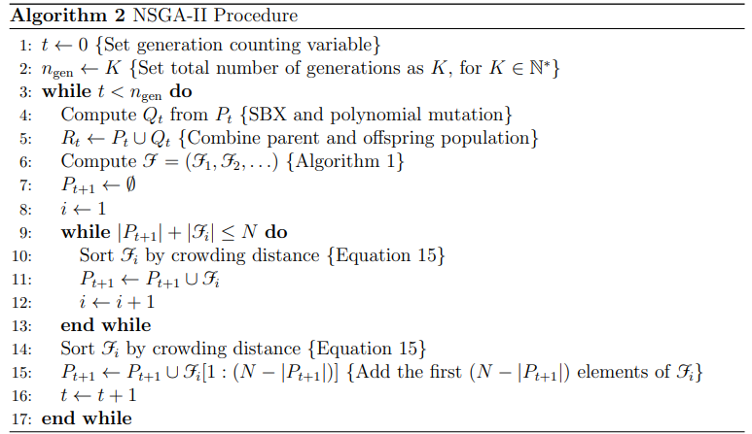
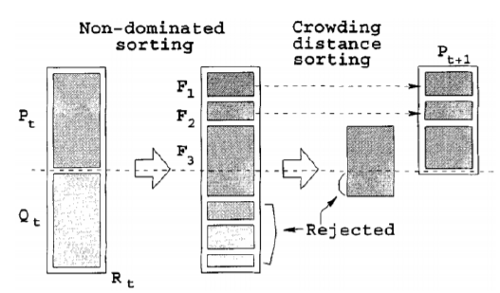
NSGA-II workflow and pseudocode
Deb, K., A. Pratap, S. Agarwal, and T. Meyarivan: A fast and elitist multiobjective genetic algorithm: Nsga-ii. IEEE Transactions on Evolutionary Computation, 6(2):182–197, 2002
21/62

Slide 22
Part 1 – Validation of code_aster modeling
Part 2 - Testing Chaboche parameter sets
Part 3 – Optimization of parameters
Part 4 – OPT parameters on specimens
Part 5 – Variable amplitude loading
5
Results and discussion
22/62

Slide 23
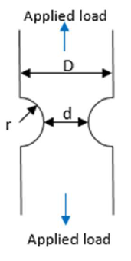
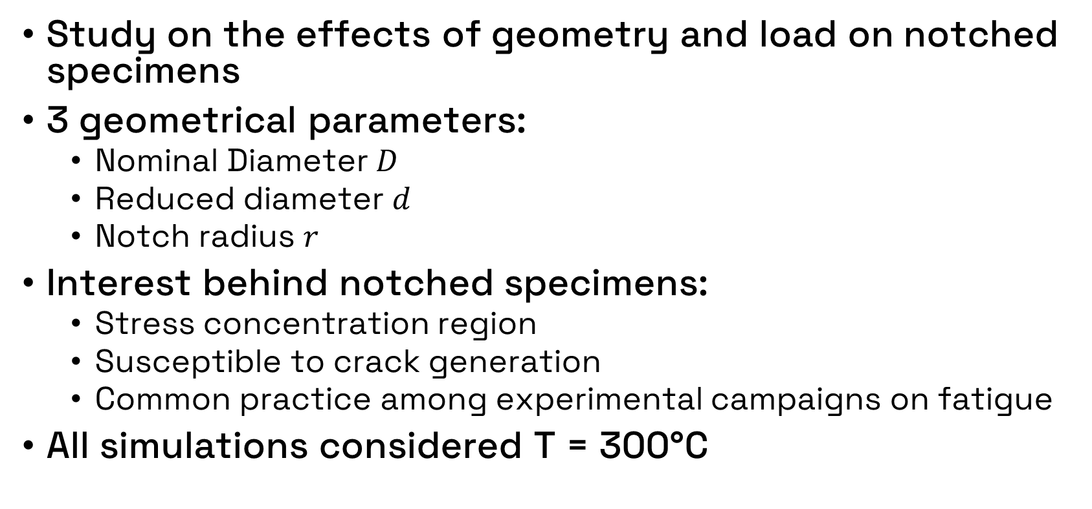
Notched specimen
Study on the effects of geometry and load on notched specimens
3 geometrical parameters:
Nominal Diameter $D$
Reduced diameter $d$
Notch radius $r$
Interest behind notched specimens:
Stress concentration region
Susceptible to crack generation
Common practice among experimental campaigns on fatigue
All simulations considered T = 300°C
23/62

Slide 24
Part 1 – Validation of code_aster modeling
Meshes used
Symmetry boundary conditions applied in order to use smaller domain and refine the mesh
Red dot
Extensometer measurement
24/62
Notch root

Slide 25
Part 1 – Validation of code_aster modeling
Initial validation of code_aster framework using cyclic stress-strain curves on INCEFA-SCALE diagnostic tests
Monotonic stress loading
25/62

Slide 26
Part 1 – Validation of code_aster modeling
Comparison of used curves with available experimental data at maximum hardening and half life stages of fatigue life
26/62

Slide 27
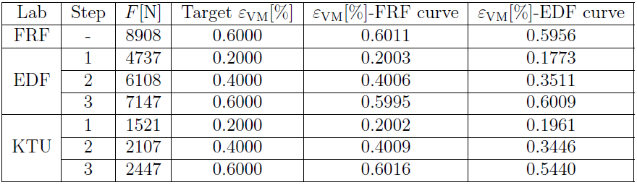
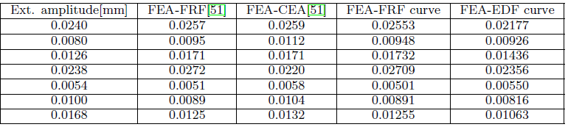
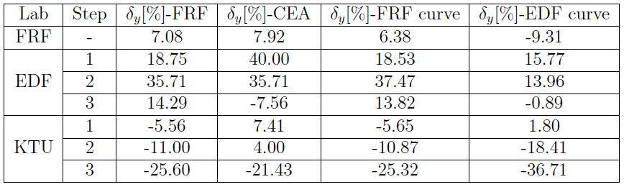
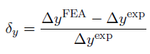
Part 1 – Validation of code_aster modeling
Results (Notch, Extensometer)
Reference
27/62
Errors similar to FRF (reference)

Slide 28
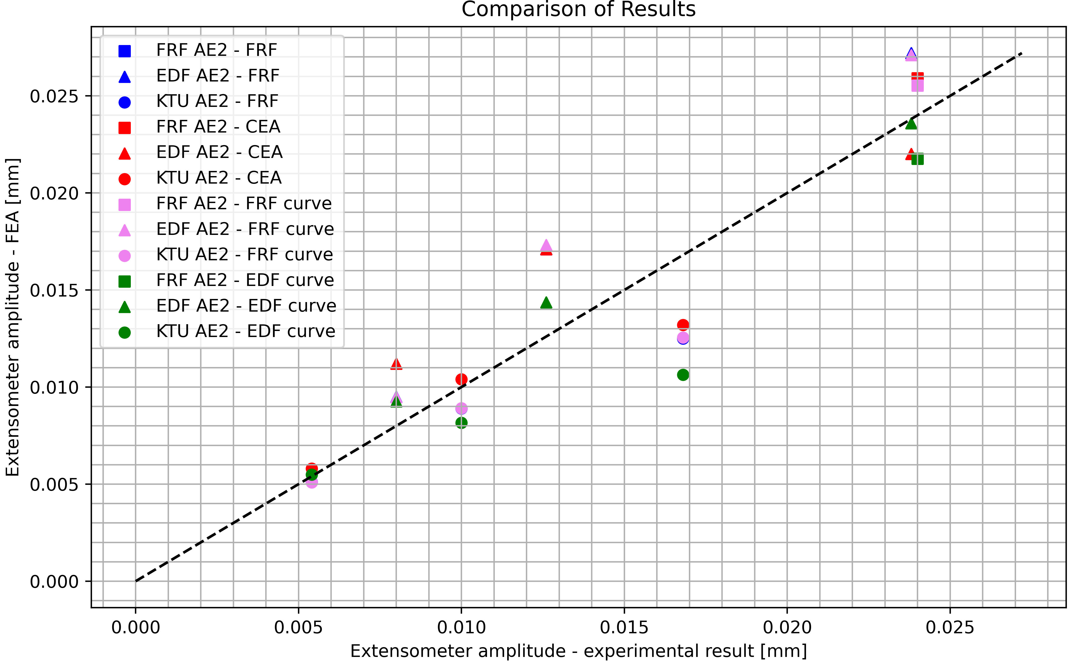
Part 1 – Validation of code_aster modeling
Present code_aster modeling is considered to have been well implemented
This gives credibility to further simulation results
28/62

Slide 29
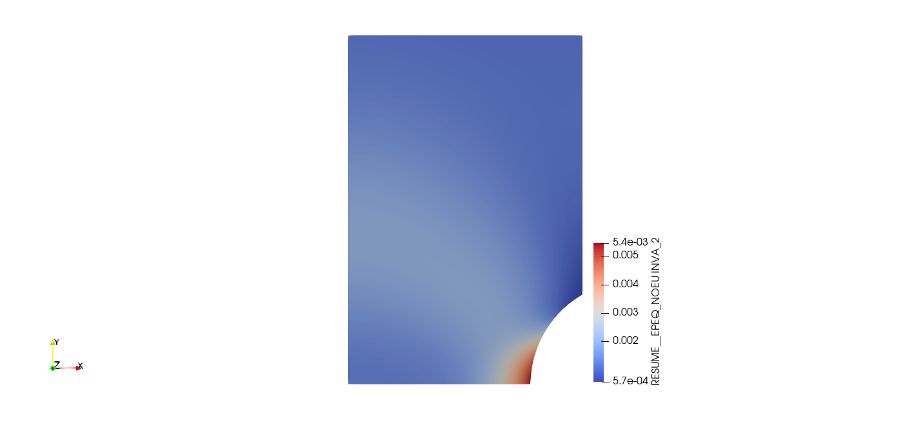
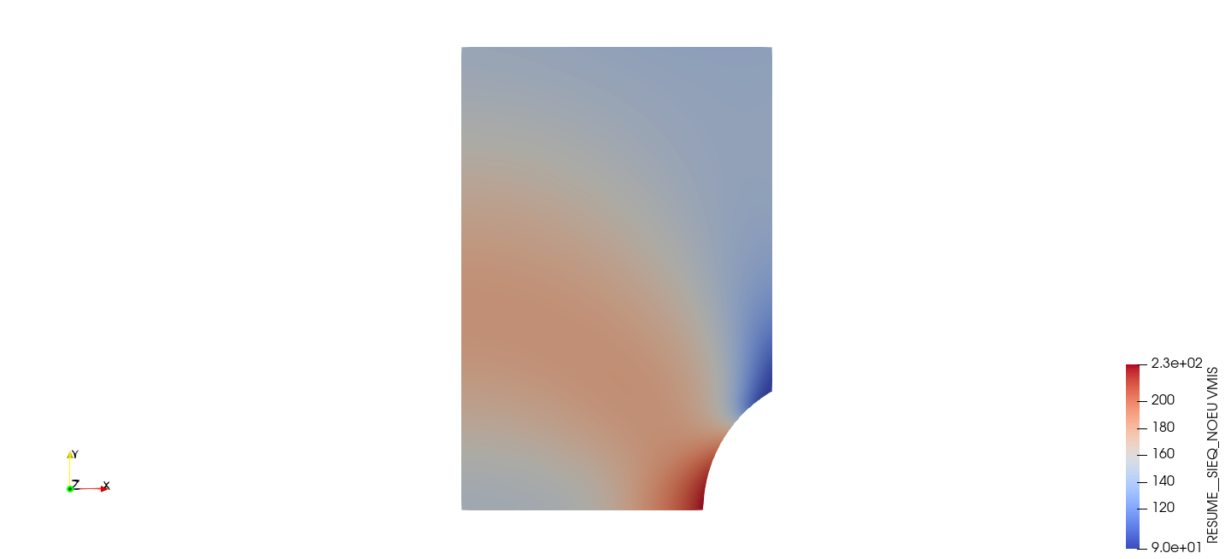
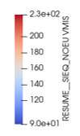
Part 1 – Validation of code_aster modeling
General strain and stress profiles (FRF specimen)
29/62

Slide 30
Part 2 – Testing Chaboche parameter sets
Former strategy cannot be used for cyclic simulations
Objective: test the parameter sets provided by CEA in the INCEFA-SCALE project and Zhang’s parameter set*
We seek to determine if any of these parameter sets is good enough to proceed with full-scale specimen simulations
First approach:
Used simple cubic mesh to reduce computational burden
30/62
*Zhang, Wen: Fatigue crack growth in large scale yielding condition. PhD thesis, Université Paris Saclay (COmUE), 2016.

Slide 31
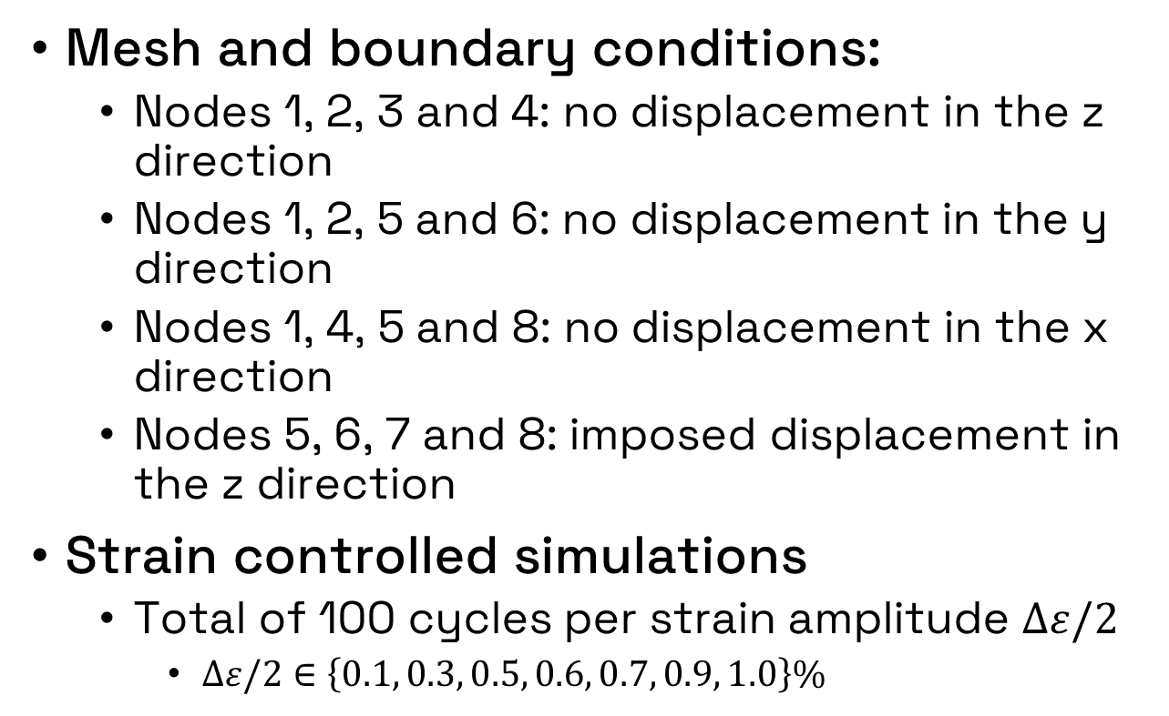
Part 2 – Testing Chaboche parameter sets
Mesh and boundary conditions:
Nodes 1, 2, 3 and 4: no displacement in the z direction
Nodes 1, 2, 5 and 6: no displacement in the y direction
Nodes 1, 4, 5 and 8: no displacement in the x direction
Nodes 5, 6, 7 and 8: imposed displacement in the z direction
Strain controlled simulations
Total of 100 cycles per strain amplitude $Δε/2$
$Δε/2∈\left\{0.1, 0.3, 0.5, 0.6, 0.7, 0.9, 1.0\right\}\%$
31/62

Slide 32
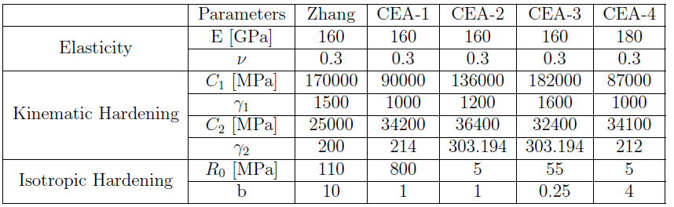
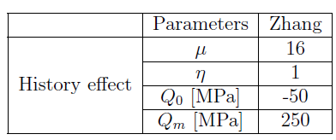
Part 2 – Testing Chaboche parameter sets
Parameter sets tested
With history effect
32/62

Slide 33
Part 2 – Testing Chaboche parameter sets
Comparison of Zhang parameters (history effect)
Best sets:
Maximum hardening:
with history effect
33/62

Slide 34
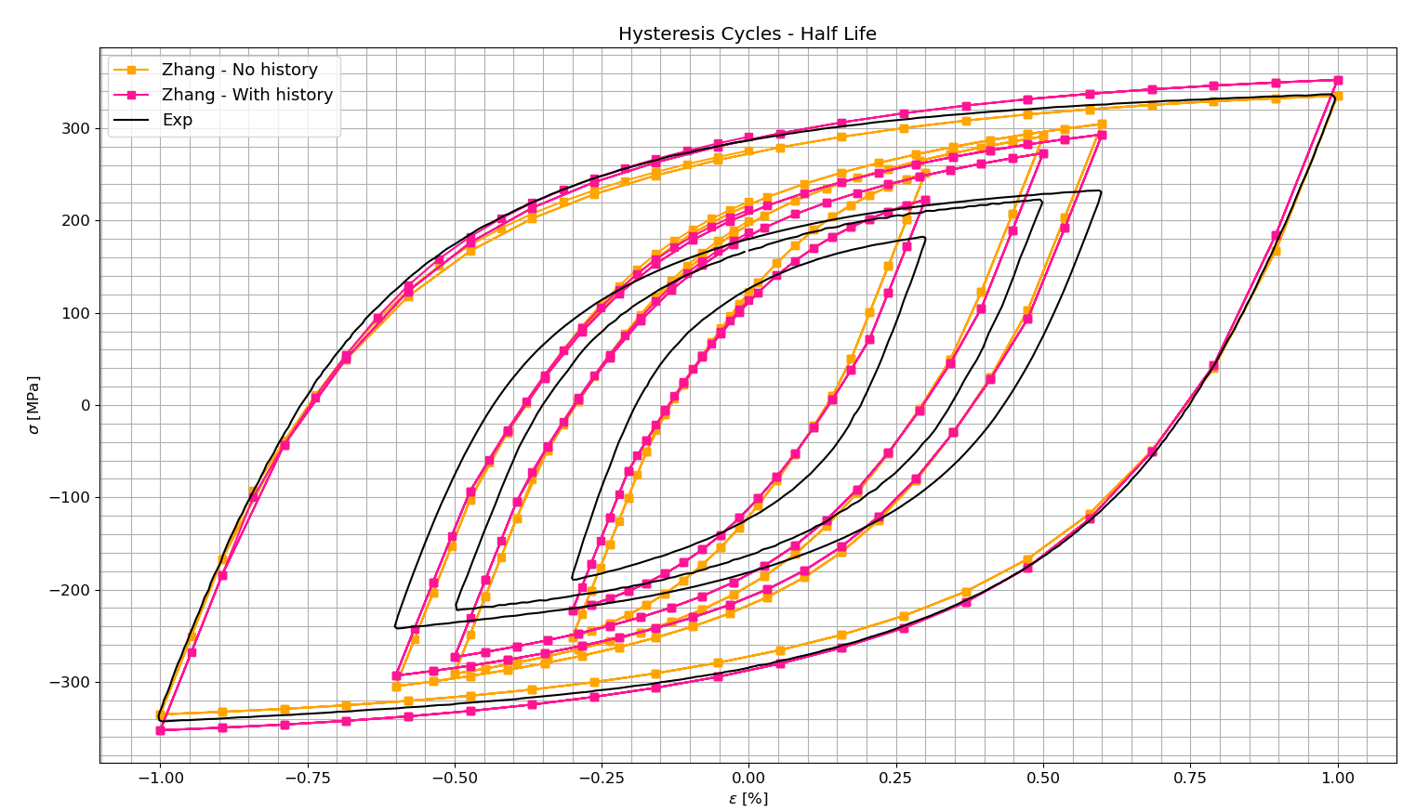
Part 2 – Testing Chaboche parameter sets
Comparison of Zhang parameters (history effect)
Best sets:
Maximum hardening:
with history effect
Half life:
without history effect
34/62

Slide 35
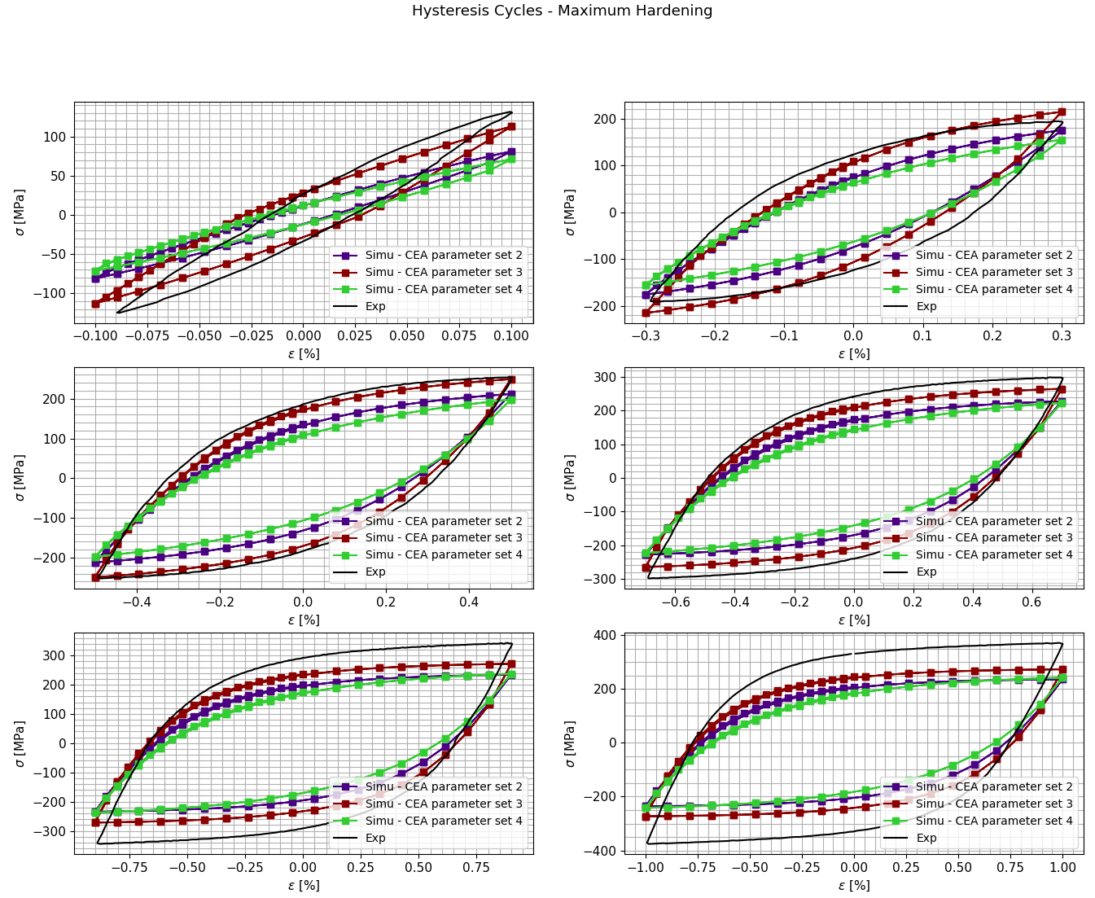
Part 2 – Testing Chaboche parameter sets
Comparison with CEA parameter sets (Parameter set 1 not considered)
Conclusion:
Maximum hardening: parameter set 3
35/62

Slide 36
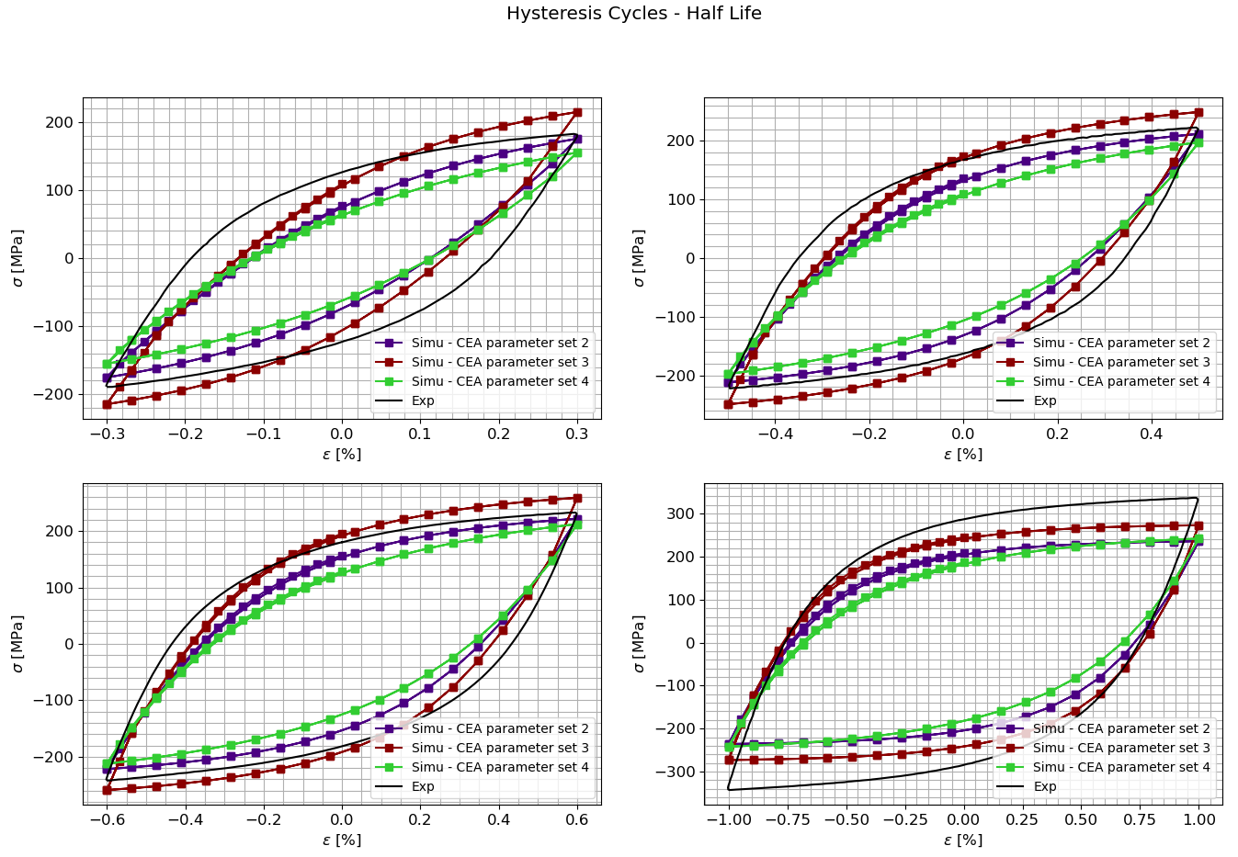
Part 2 – Testing Chaboche parameter sets
Comparison with CEA parameter sets (Parameter set 1 not considered)
Conclusion:
Maximum hardening: parameter set 3
Half life: parameter set 2
36/62

Slide 37
Part 2 – Testing Chaboche parameter sets
Comparison of best parameter sets
37/62

Slide 38
Part 2 – Testing Chaboche parameter sets
Comparison of best parameter sets
CEA sets suitable for smaller strain ranges
Zhang sets suitable for bigger strain ranges
38/62

Slide 39
Part 2 – Testing Chaboche parameter sets
The rest of the work focuses only on analyzing the half life stage, for the interest of the INCEFA-SCALE project
The best parameter sets (Zhang without history effect and CEA 2) were tested on FRF diagnostic specimen
Stress controlled simulation
Present FEA results are not good
→ Optimization of these parameters is to be conducted
39/62

Slide 40
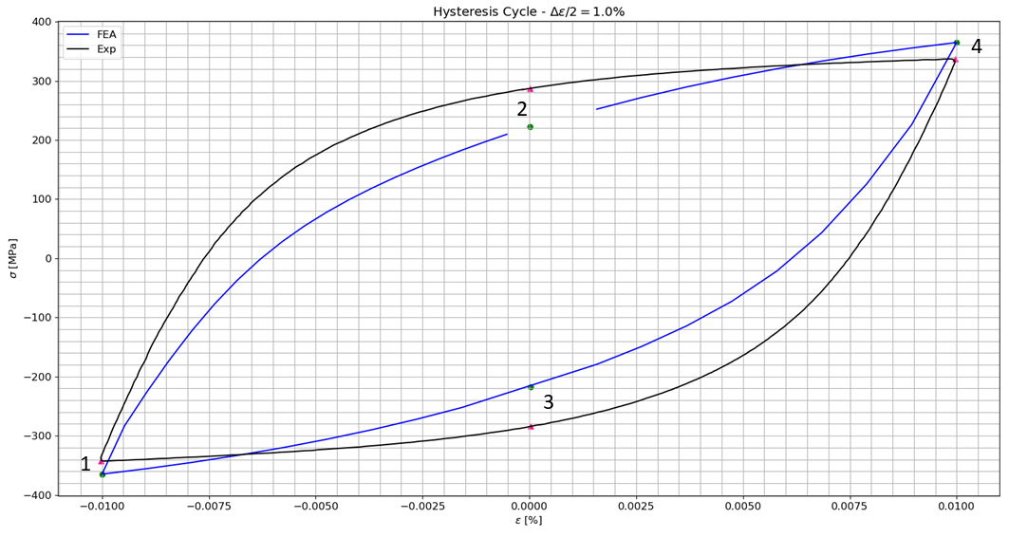
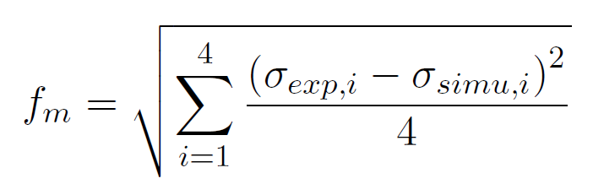
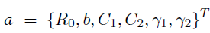
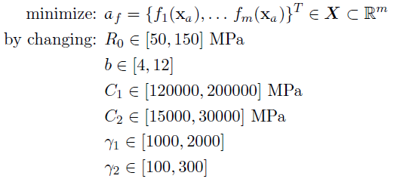
Part 3 – Optimization of parameters
NSGA-II algorithm implemented considering:
Objective functions:
DoE:
Formulation:
40/62

Slide 41
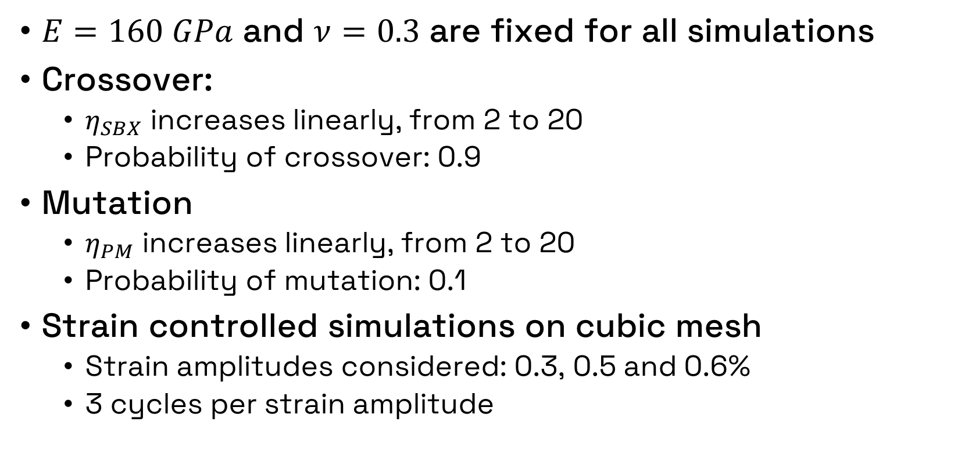
Part 3 – Optimization of parameters
$E=160 GPa$ and $ν=0.3$ are fixed for all simulations
Crossover:
$η_{SBX}$ increases linearly, from 2 to 20
Probability of crossover: 0.9
Mutation
$η_{PM}$ increases linearly, from 2 to 20
Probability of mutation: 0.1
Strain controlled simulations on cubic mesh
Strain amplitudes considered: 0.3, 0.5 and 0.6%
3 cycles per strain amplitude
41/62

Slide 42
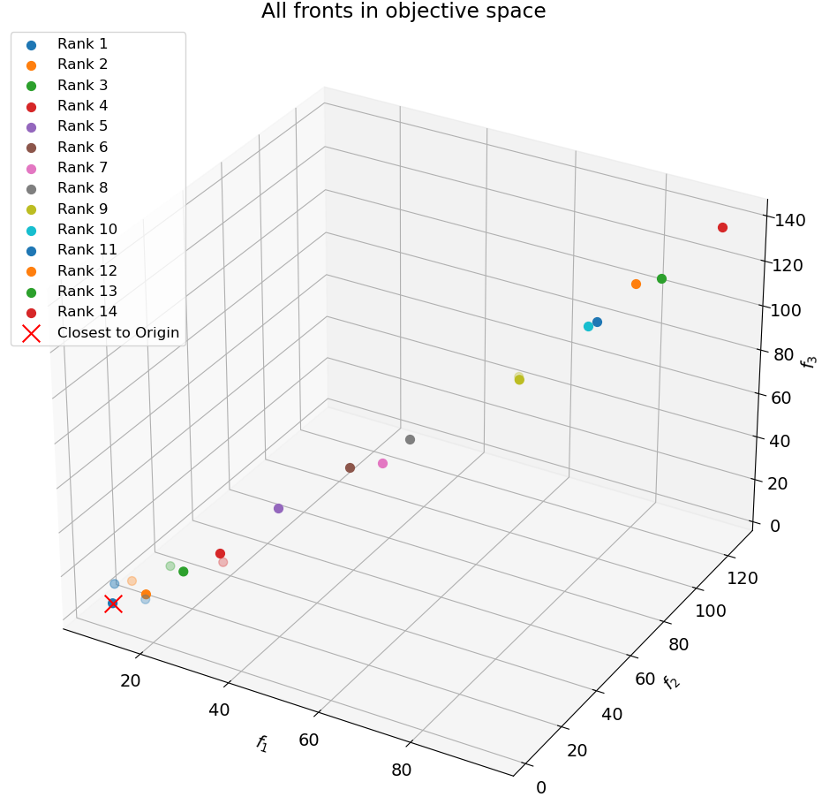
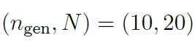
Part 3 – Optimization of parameters
Objective space for all 3 runs
1st run:
42/62

Slide 43
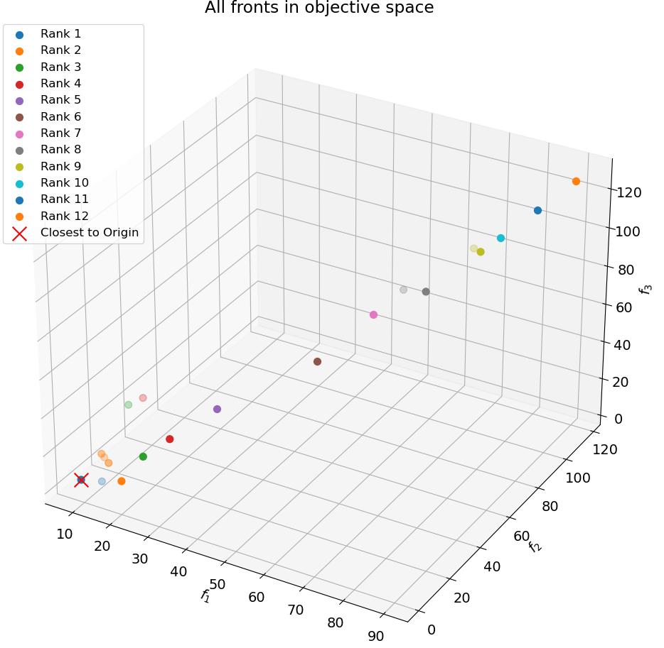
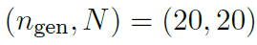
Part 3 – Optimization of parameters
Objective space for all 3 runs
1st run:
2nd and 3rd run:
43/62

Slide 44
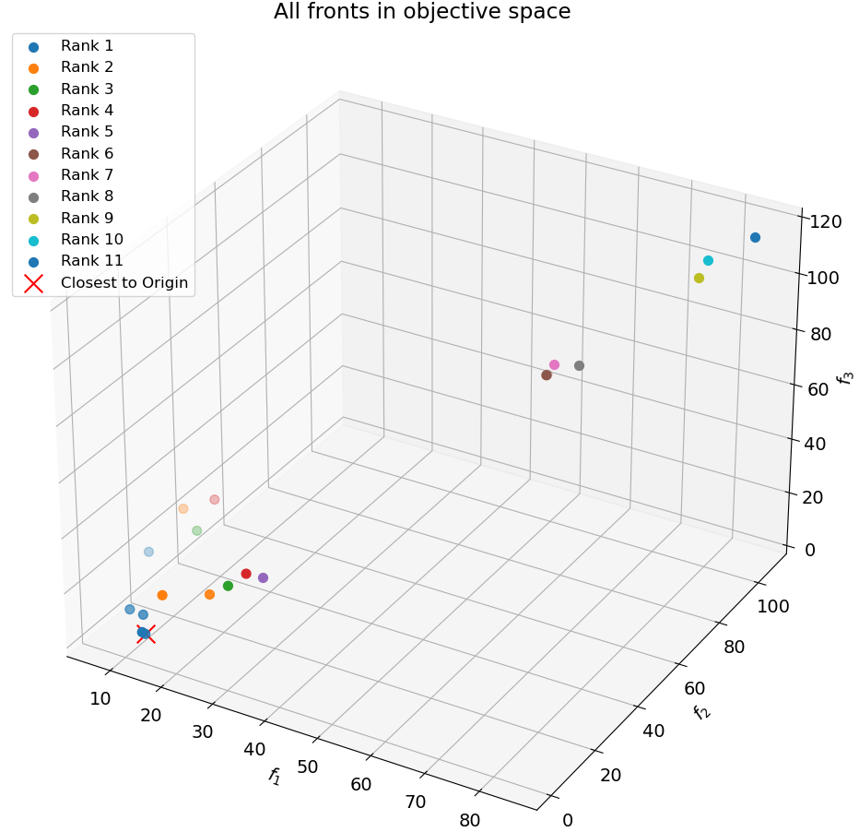
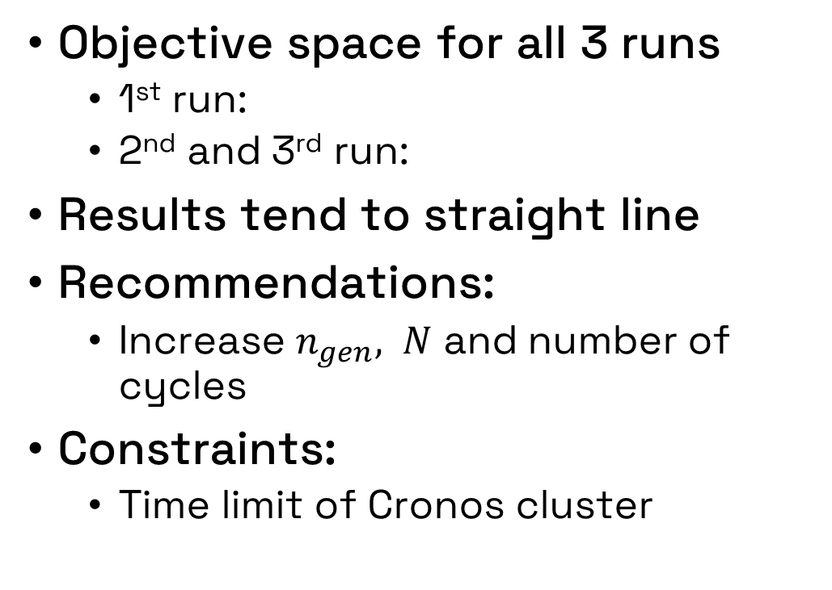
Part 3 – Optimization of parameters
Objective space for all 3 runs
1st run:
2nd and 3rd run:
Results tend to straight line
Recommendations:
Increase $n_{gen}, N$ and number of cycles
Constraints:
Time limit of Cronos cluster
44/62

Slide 45
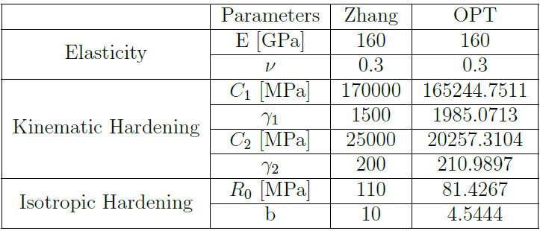
Part 3 – Optimization of parameters
Obtained parameter set:
45/62

Slide 46
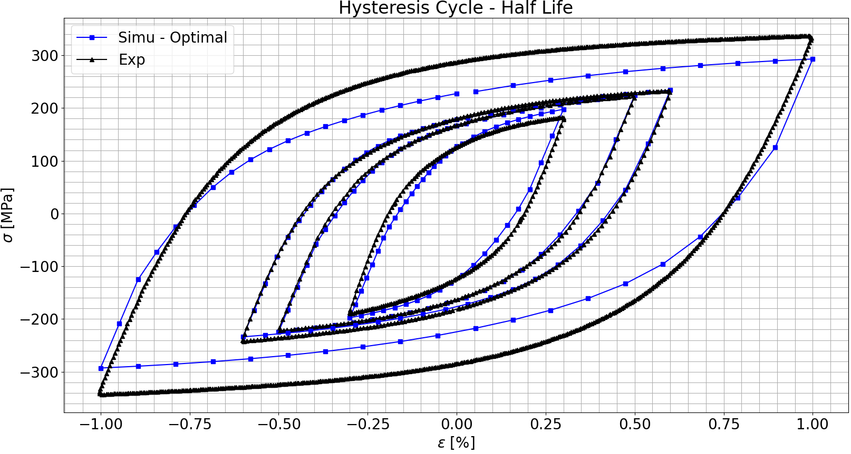
Part 3 – Optimization of parameters
Hysteresis cycle comparison
46/62

Slide 47
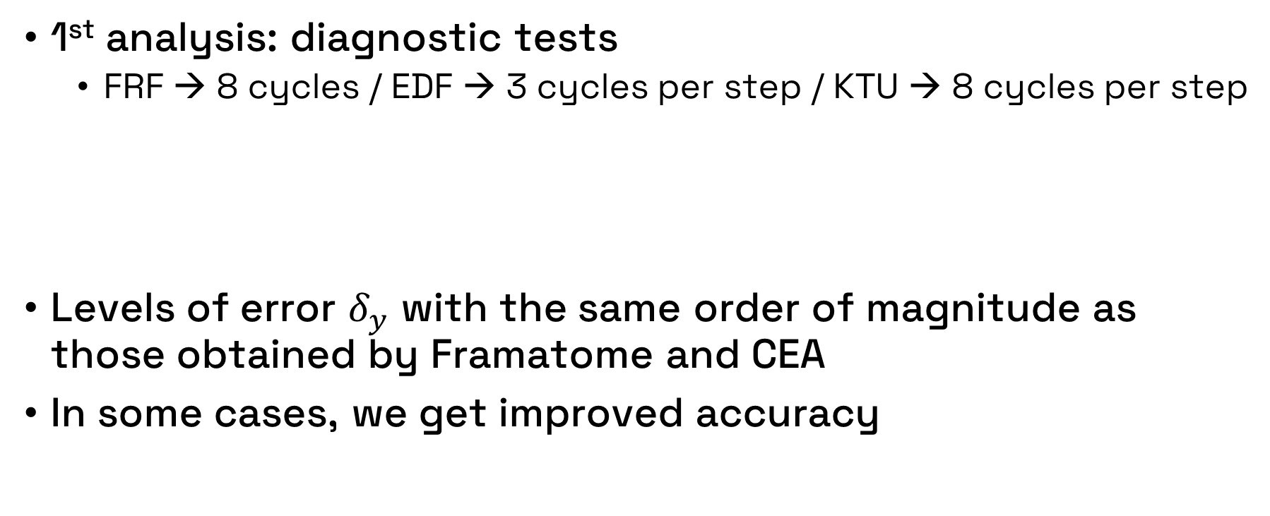
Part 4 –OPT parameters on specimens
1st analysis: diagnostic tests
FRF → 8 cycles / EDF → 3 cycles per step / KTU → 8 cycles per step
Levels of error $δ_{y}$ with the same order of magnitude as those obtained by Framatome and CEA
In some cases, we get improved accuracy
47/62

Slide 48
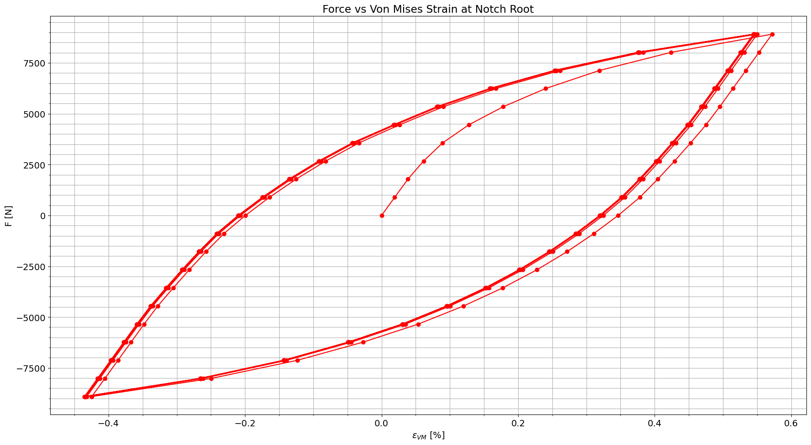
Part 4 –OPT parameters on specimens
Possible to obtain hysteresis cycles at notch root
48/62

Slide 49
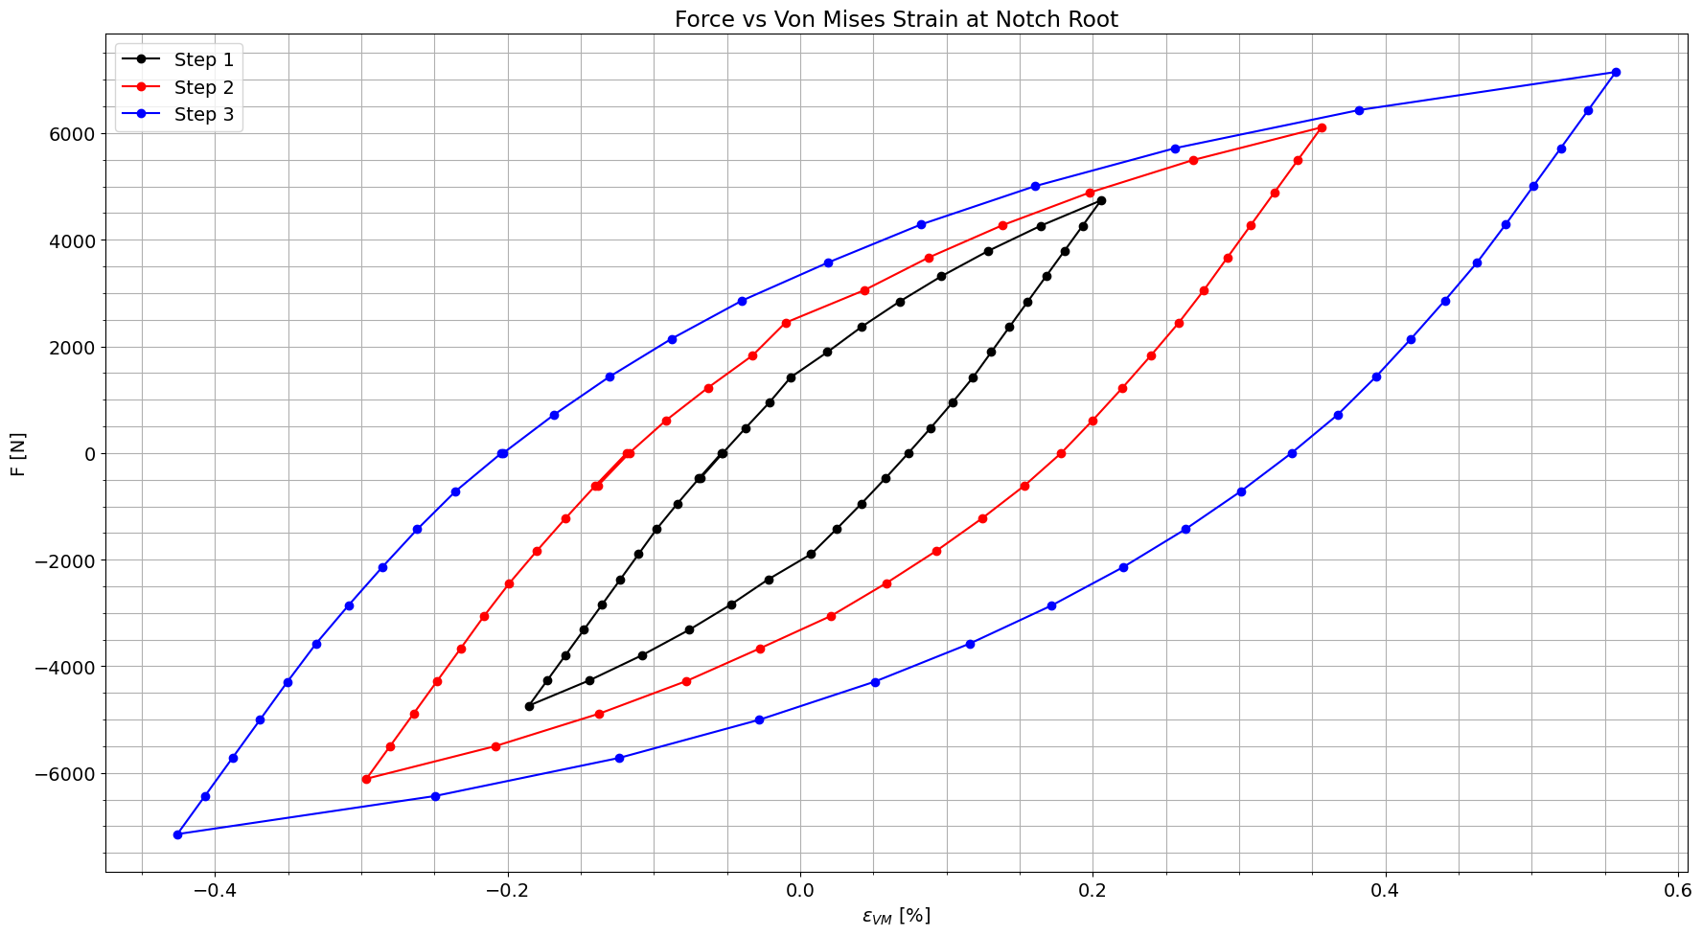
Part 4 –OPT parameters on specimens
Possible to obtain hysteresis cycles at notch root
49/62

Slide 50
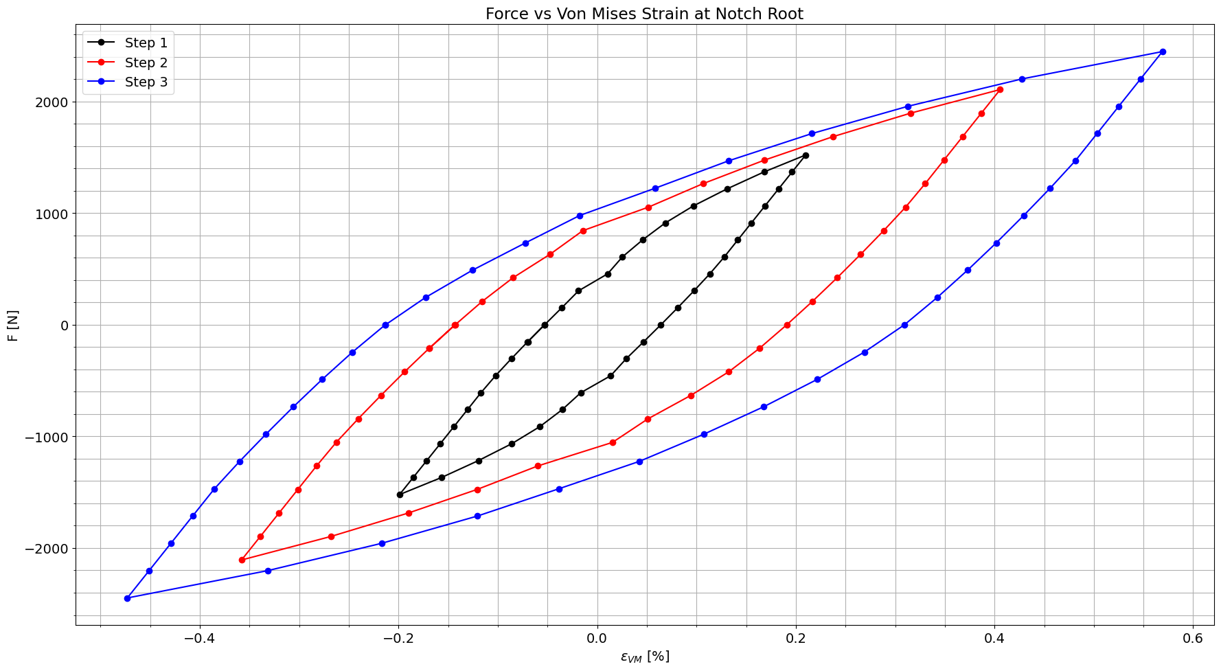
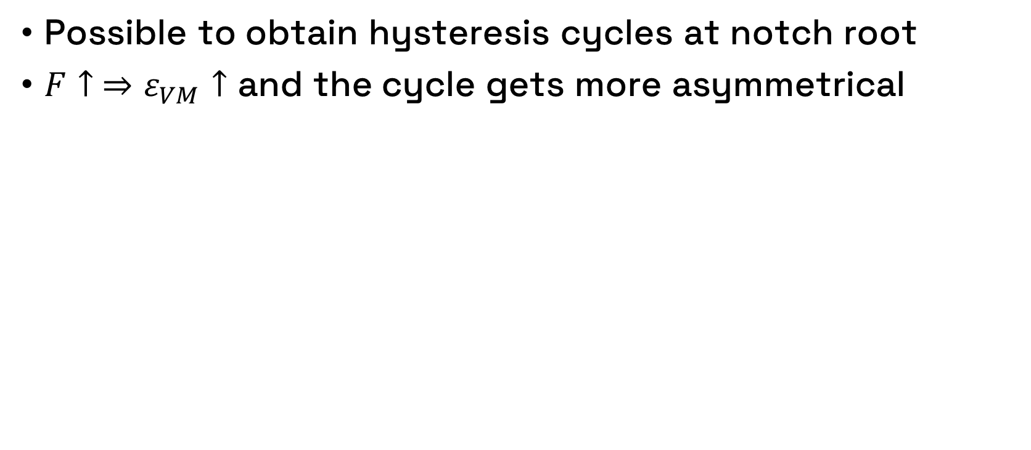
Part 4 –OPT parameters on specimens
Possible to obtain hysteresis cycles at notch root
$F↑ ⇒ε_{VM}↑$ and the cycle gets more asymmetrical
50/62

Slide 51
Part 4 –OPT parameters on specimens
Implementation on specimens yet to be tested
New meshes:
51/62

Slide 52
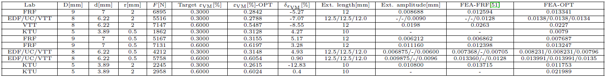
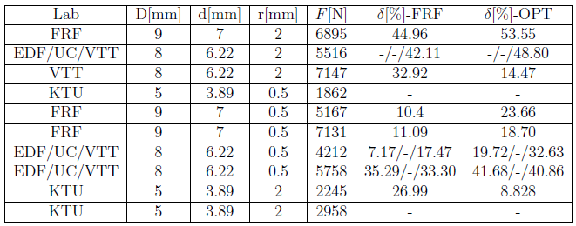
Part 4 –OPT parameters on specimens
Obtained results
52/62

Slide 53
Part 4 –OPT parameters on specimens
Conclusion:
Zhang and CEA parameter sets were not adequate for the half life stage of the 316L steel
Development of an optimization framework to find optimal parameter set
Results are promising, and there is now available numerical data for experiments yet to be conducted
53/62

Slide 54
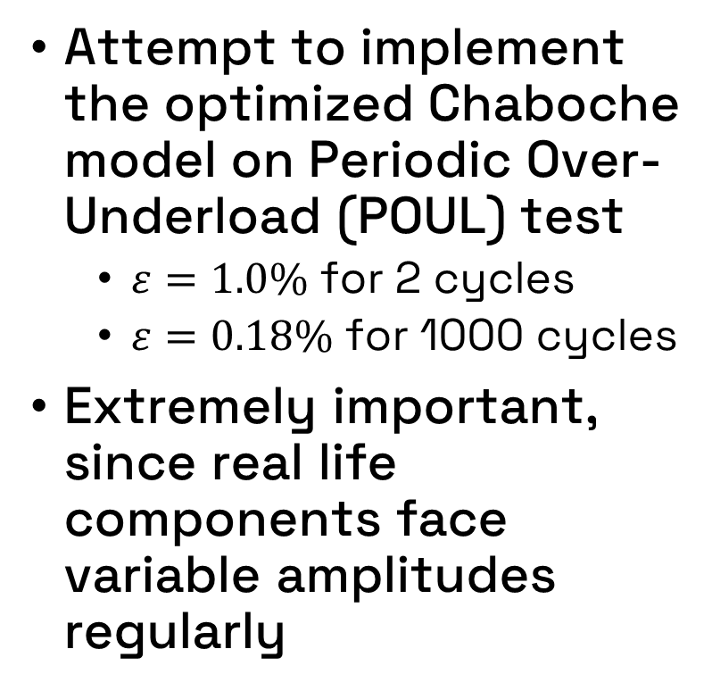
Part 5 –Variable amplitude loading
Attempt to implement the optimized Chaboche model on Periodic Over-Underload (POUL) test
$ε=1.0\%$ for 2 cycles
$ε=0.18\%$ for 1000 cycles
Extremely important, since real life components face variable amplitudes regularly
54/62

Slide 55

Part 5 –Variable amplitude loading
Strategy: implement Zhang parameters at $Δε/2=1.0\%$ and OPT parameters at $Δε/2=0.18\%$
Attempt to extract the best out of the two parameter sets
Strain controlled simulations conducted on the cubic mesh
Impossible to implement 1000 cycles at$Δε/2=0.18\%$per periodic repetition
Solution: 20 cycles to achieve stabilization, then repeat the result until 1000 cycles for comparison with experimental results
55/62

Slide 56

Part 5 –Variable amplitude loading
56/62

Slide 57

Part 5 –Variable amplitude loading
57/62

Slide 58
Part 5 –Variable amplitude loading
Conclusion:
Fairly good results for the first periodic repetition
FEA results not capturing progressive hardening
Zhang parameters designed to capture stress levels at maximum hardening or half life
Furthermore, OPT parameters are not capturing previous deformation state
Lack of history effect
Approach of multiple constitutive model parameter sets looks promising
Further exploration of this method could be interesting
58/62

Slide 59
6
Conclusion
59/62

Slide 60
Conclusion
Initially, the objective was to reproduce INCEFA-SCALE fatigue tests
Shift in research objective due to Chaboche model parameters not being suitable
Implementation of NSGA-II evolutionary algorithm to tackle this problem
Good FEA results obtained with multiple specimens
Further work must be done on variable amplitude loading tests
60/62

Slide 61
Thank you for your attention!
61/62

Slide 62
Main references
Zhang, Wen: Fatigue crack growth in large scale yielding condition. PhD thesis, Université Paris Saclay (COmUE), 2016.
Deb, K., A. Pratap, S. Agarwal, and T. Meyarivan: A fast and elitist multiobjective genetic algorithm: Nsga-ii. IEEE Transactions on Evolutionary Computation, 6(2):182–197, 2002
EDF: Incefa-scale report d4.2 - mo36 modelling progress. Unpublished project report, 2024.
62/62

